Slide 1


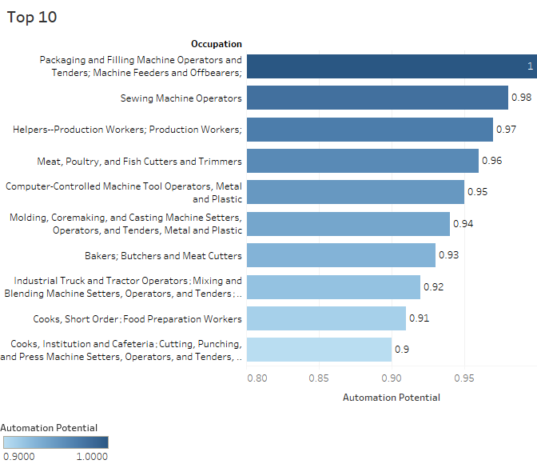
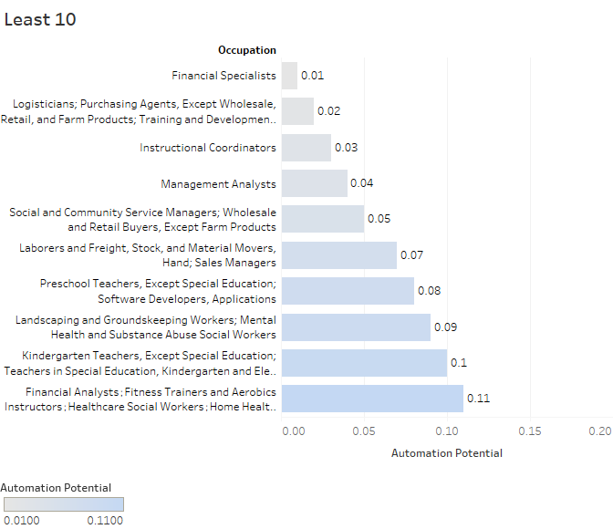
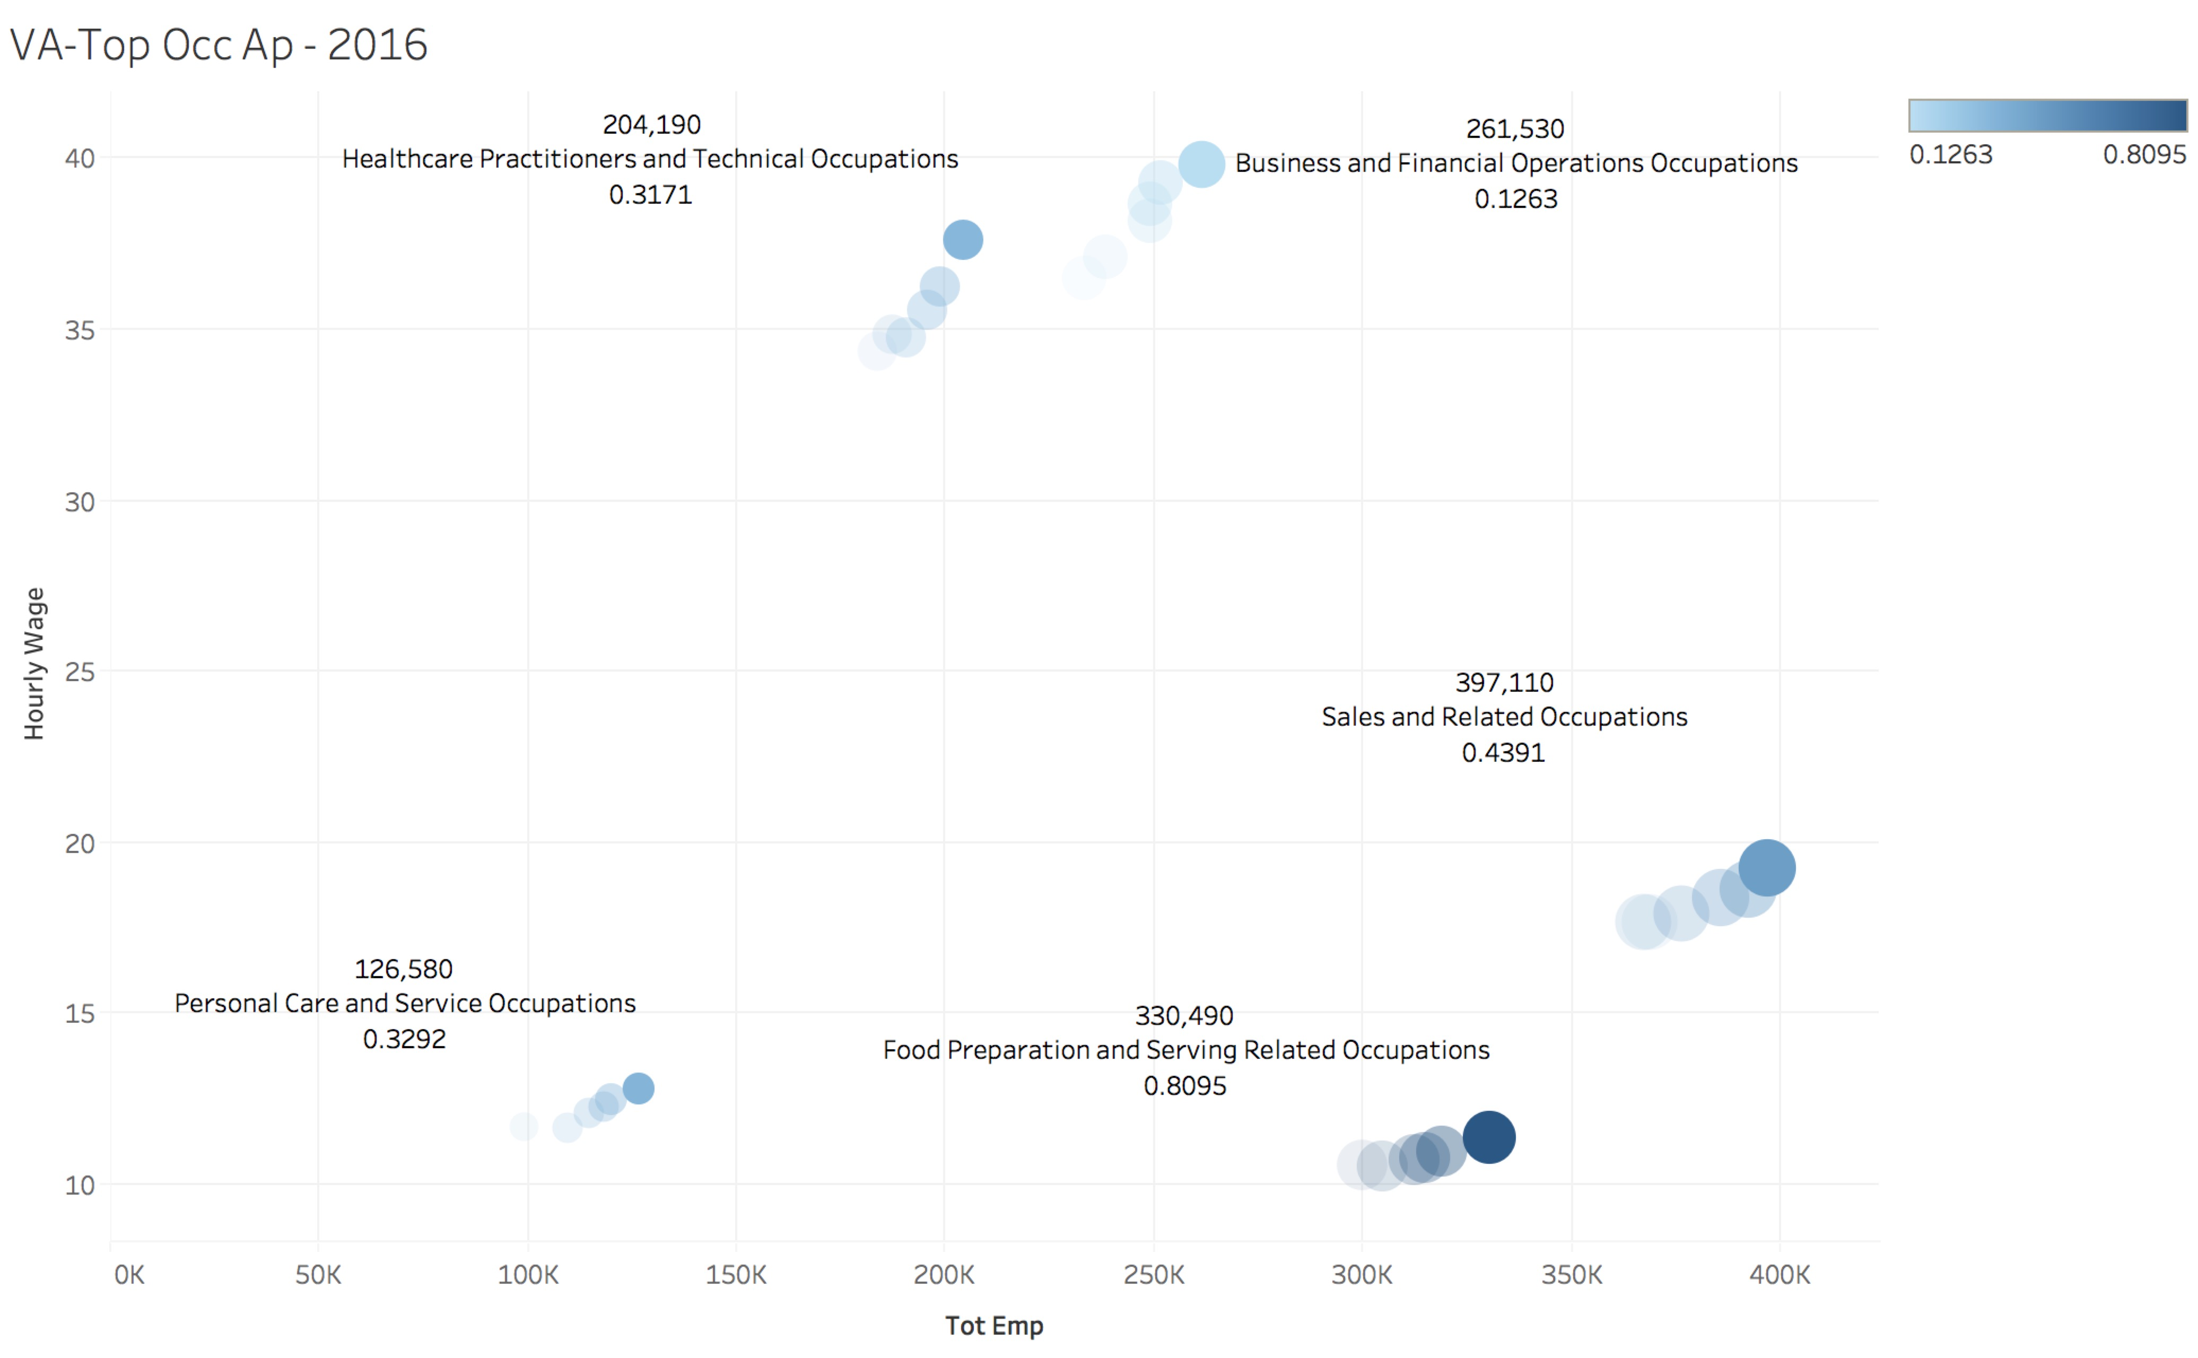
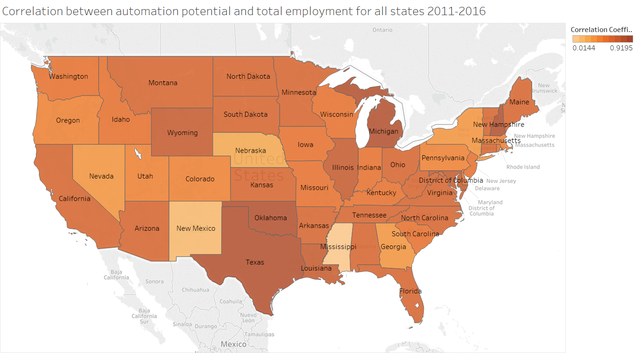
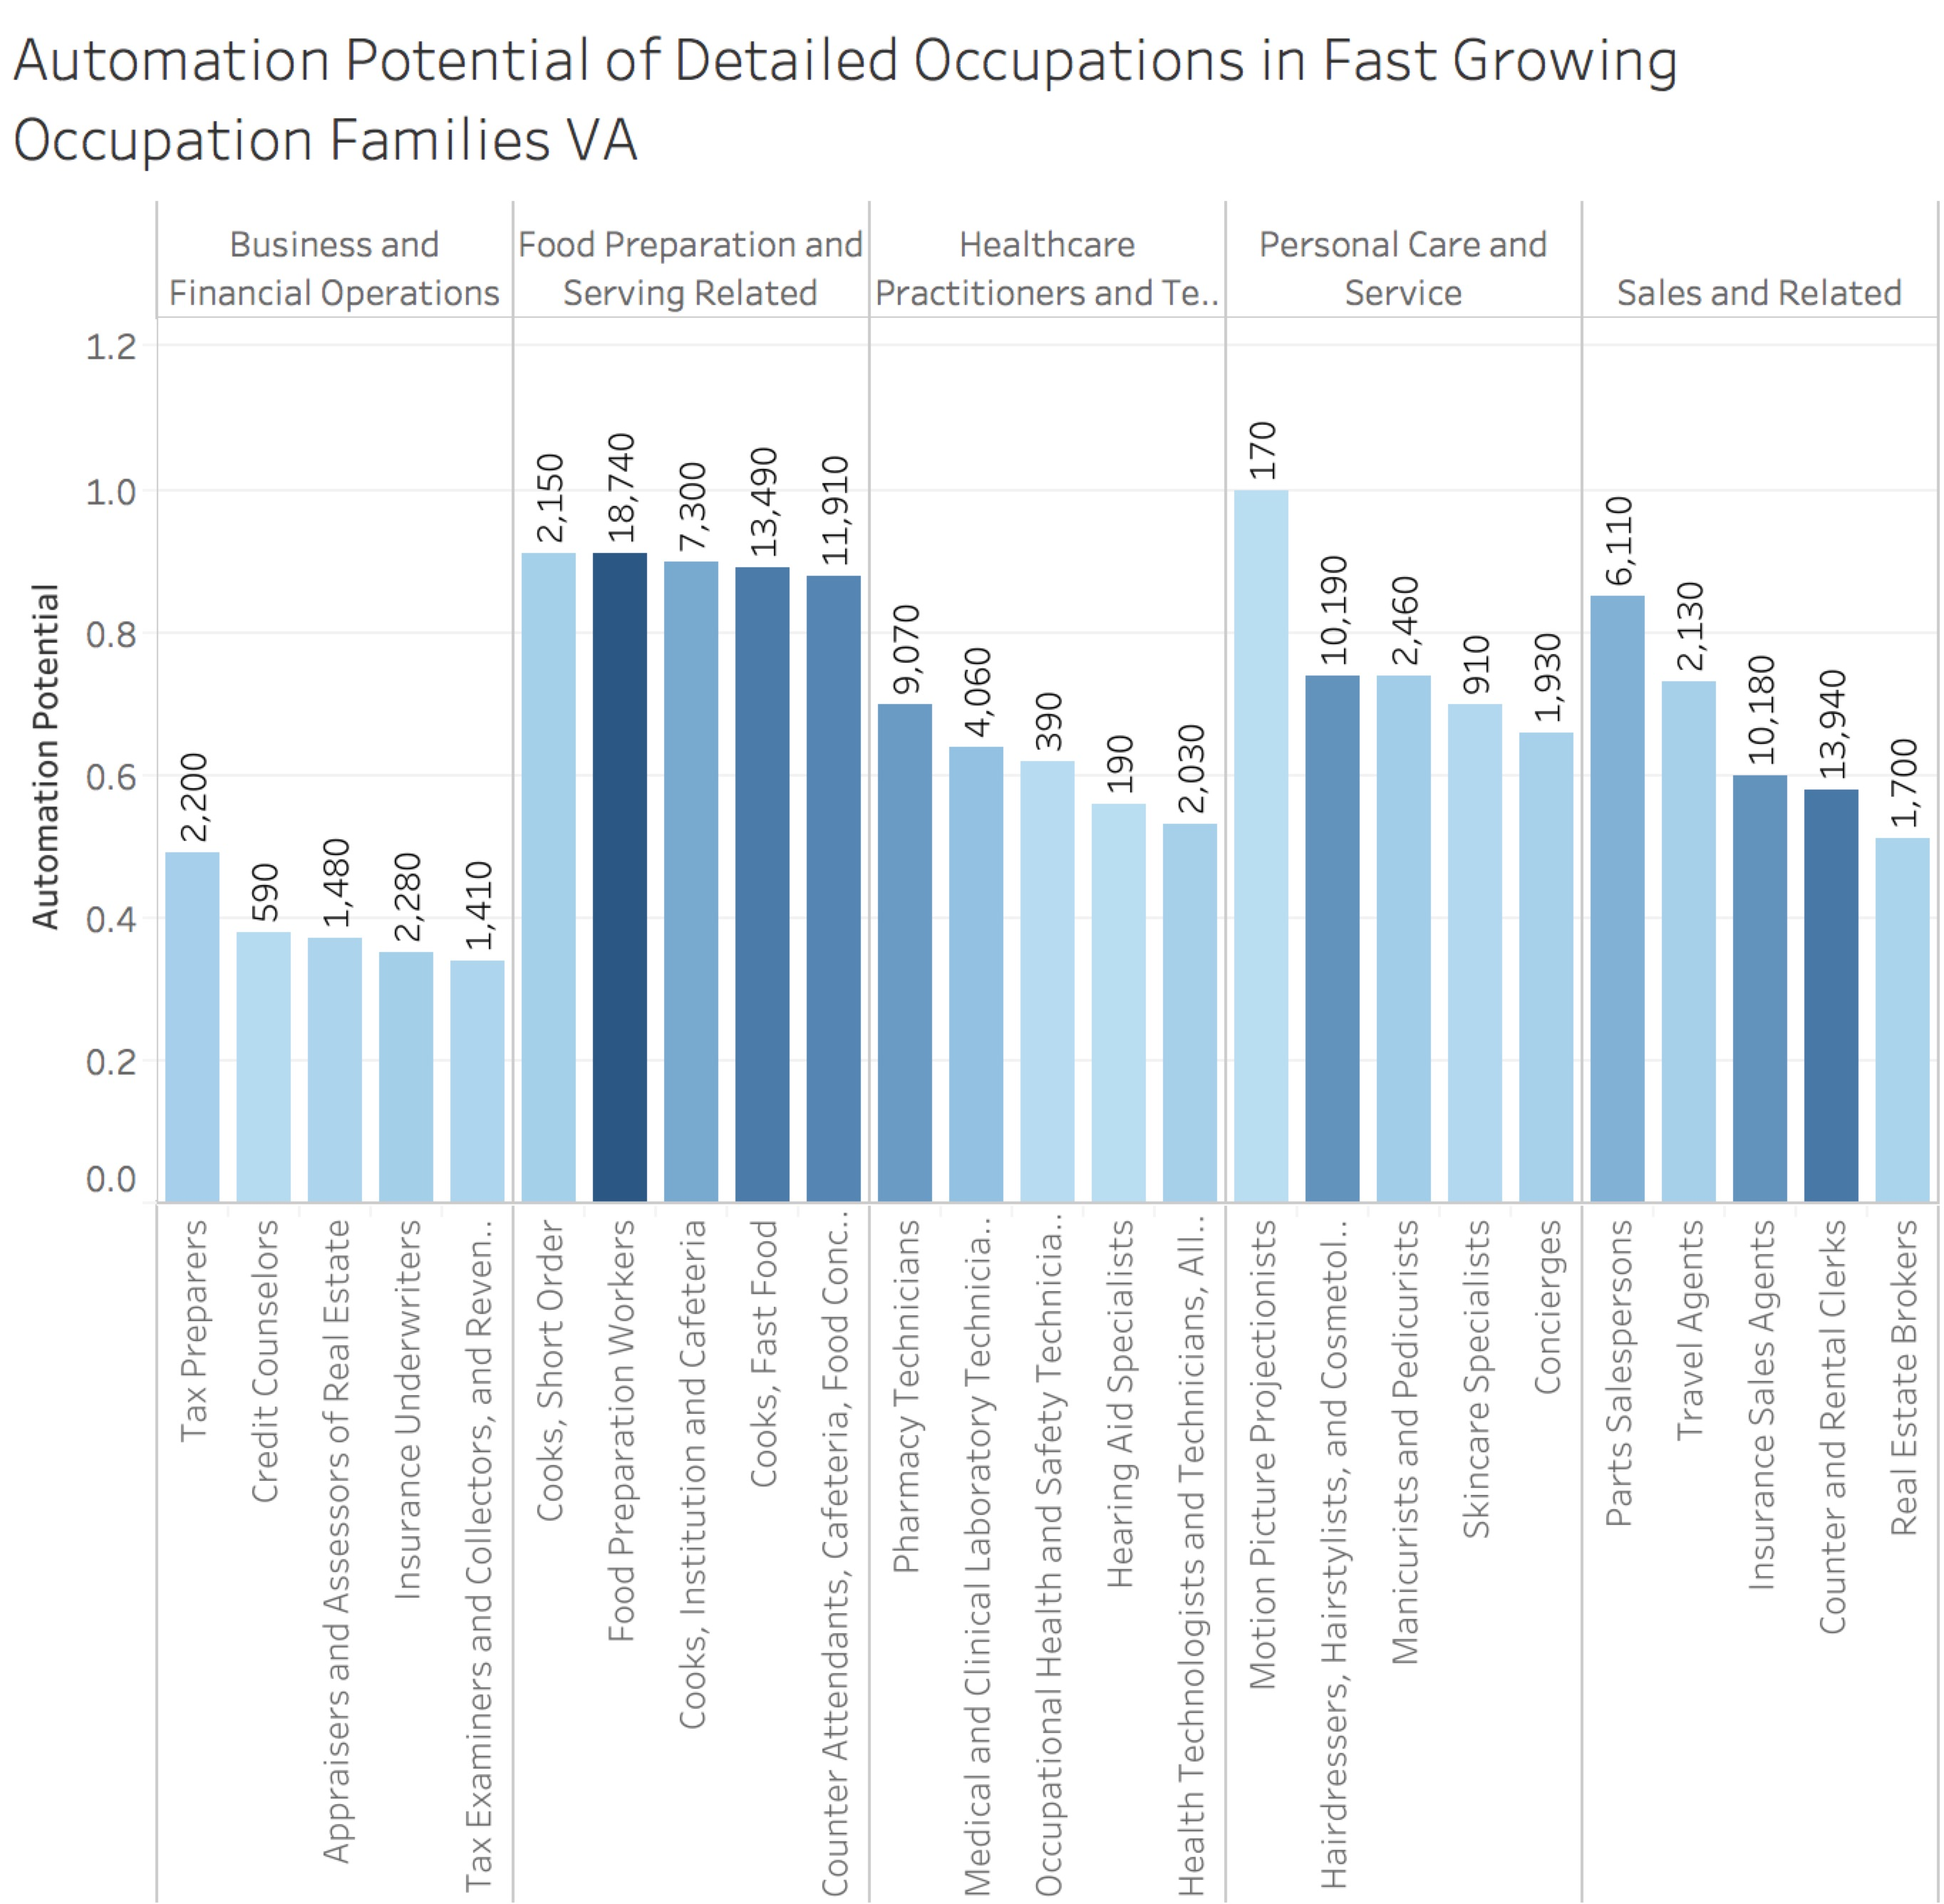
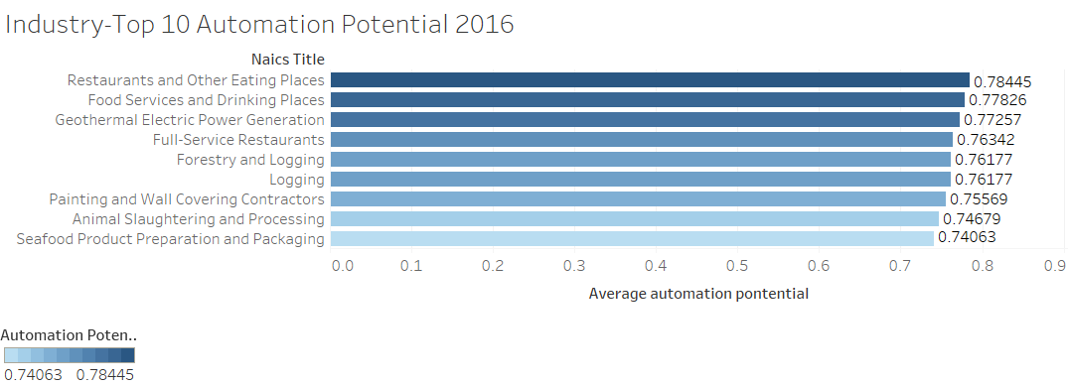
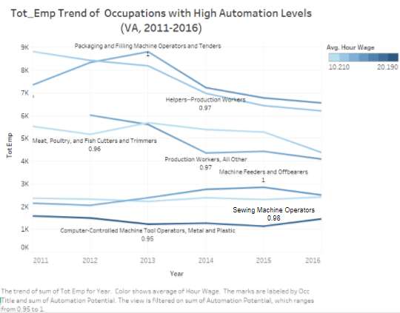
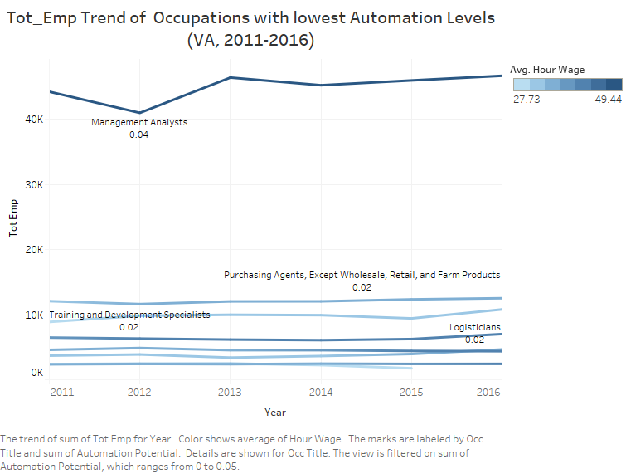
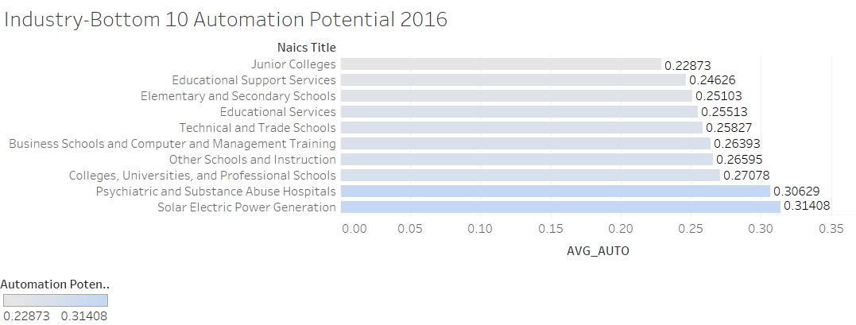
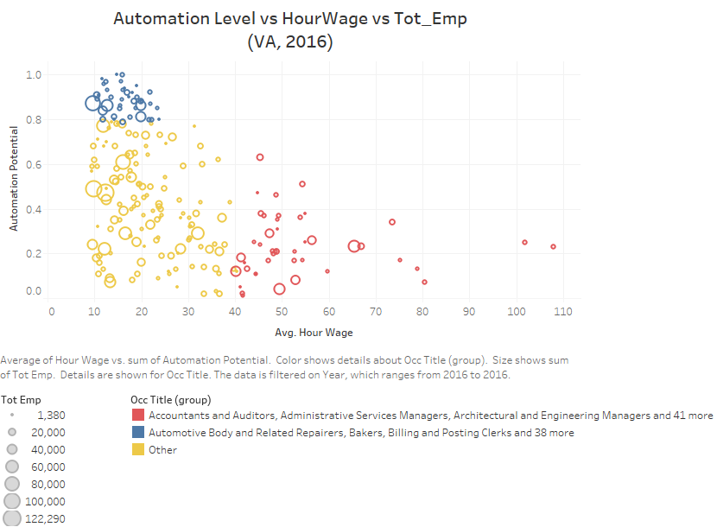
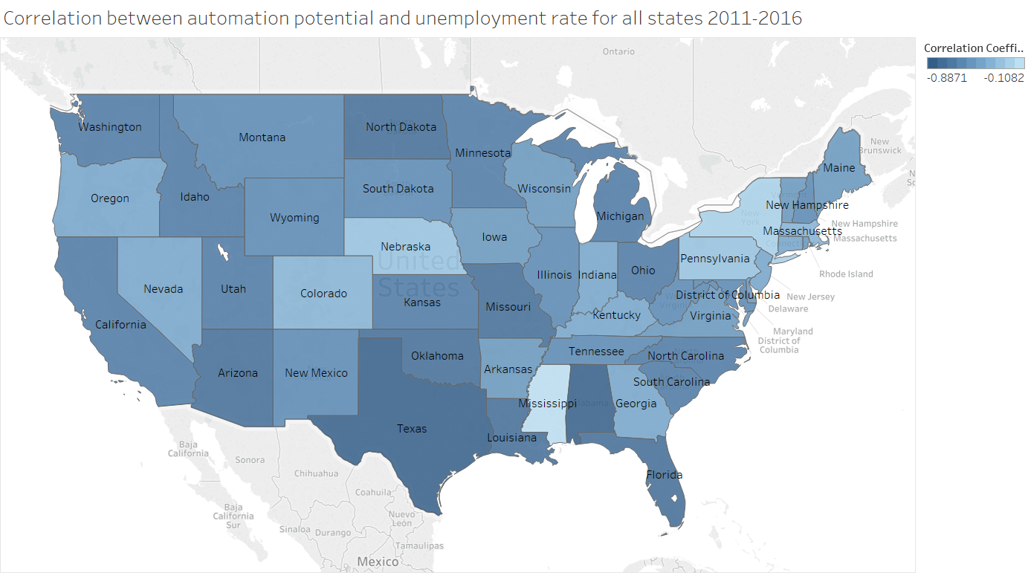
AI Technology and the Future of Employment
Qing Chen, Kangning Gao, Weiwei Li, and Larry Medsker
Abstract
Exploratory Analysis
Results
More Results
This project integrates the latest data science methods to identify critical impacts of artificial intelligence and data science on future labor market. The goal is to clarify the specific nature of possible disruptions to the job market, identify and analyze relevant data, and use visualization techniques to identify potential possible actions and policies that may mitigate the impact of automation on jobs. United States employment patterns are a complex mix of factors, including demographics, economics, growth in technology, and government policies on job creation. The issues vary due to regional differences, incentives for new businesses, and the growth in technology. Automation potential estimated by McKinsey is used as the technology index in this project. The research reported here focuses on a particular region first, the Commonwealth of Virginia, as an example of using data science to anticipate disruptions in future employment by artificial intelligence and data science. Further, the analysis is extended from VA occupations to industries on the national level.
Background
According to the MGI (the McKinsey Global Institute) report [1], the automation potential is the technical likelihood of automation. Given currently demonstrated technologies, almost every occupation has partial automation potential, as a proportion of its activities could be automated. So MGI focused on analyzing the automation potential of individual activities rather than the entire occupations. They used the state of technology in respect to 18 performance capabilities to estimate the technical automation potential of more than 2,000 work activities from more than
800 occupations across the US economy (based on data from the US Department of Labor), and then broadened the analysis across the global economy. Specifically, they used a disaggregation of occupations into constituent activities that people are paid to do in the global workplace. Each of these activities requires some combination of 18 performance capabilities, which are in five groups: sensory perception, cognitive capabilities, natural language processing, social and emotional capabilities, and physical capabilities. Then they estimated the level of performance for each of these capabilities that is required to perform each work activity successfully, based on
the way humans currently perform activities—that is, whether the capability is required at all, and if so, whether the required level of performance was at roughly a median human level, below median human level, or at a high human level of performance (for example, top 25th percentile). They then assessed the performance of existing technologies today based on the same criteria.
Fig. 1. Occupations with top 10 and bottom 10 automation potentials
Fig. 4. Fast growing occupation families in VA
Fig. 7. Correlation between automation potential and total employment by states 2011-2016
Research Objective
Fig. 2. Top 10 and bottom 10 automation potential occupations employment trend
This research seeks to answer the big question, “Will technology create more jobs than are destroyed?” The project uses data on trends in demographics, McKinsey’s automation potential, and the economic models for assessing automation potential of different occupations and industries, and recent technological advances to predict occupation and employment trends in the next decade. Data science methods used in this research include machine learning, exploratory analytics of big data, and complex visualization for communication of predictive analytics. Our overall researc2h goals include application of AI and deep learning to economics data. This work could inform ways to align state policies on job creation with likely impacts of automation on the number and types of future jobs.
Fig. 8. Industries with top 10 and bottom 10 automation potential
Fig. 5. Detailed occupations with top 5 automation potential in fast growing occupation families
Conclusions
Methods
1. In the extreme cases (for occupations with highest and lowest automation potentials), automation potentials and employment (number of employees) have a negative correlation. However, overall, at state and national levels, automation potential has a negative correlation with unemployment rate, and has a positive correlation with number of employees.
2. For most states, the expected automation potentials are increasing. In our model, this means population flows from occupation with relatively low automation potential to high automation potential. If this trend keeps growing, it could be dangerous for the labor market in the next decade, when most people in these occupations can be replaced.
3. There is a negative correlation between automation potential and salary, which implies increasing automation potential in one occupation might lead to stagnate salaries.
4. Occupations in most public areas have relatively low automation potential, and these occupations can probably be considered still “safe” from being automated by current technology. Applying new technology to these related industries could be more beneficial.
Use MGI automation potential as technology indices to evaluate the impacts of AI on employment, collect data from MGI for 750 different detailed occupations.
Use 2011-2016 Bureau of Labor Statistics (BLS) data for different occupations on national level and state level, calculate the average (expected) automation potential for each state and each national-level industry weighted by population ratio of each involving detailed occupation.
Investigate VA occupations with highest and lowest automation potential (Fig 1-2), evaluate the correlation between automation potential and hourly wage (Fig 3).
Analyze VA fast growing occupation families based on average total employment change (Fig 4-5), using average automation potential weighted by population ratio.
Evaluate state-level correlation map (Fig 6-7): unemployment rate vs. average automation potential, total employment vs. average automation potential. Illustrate the top 10 and bottom 10 industries in terms of average automation potential (Fig 8).
Use Excel, SQL, R for data processing, and Tableau for visualization.
For future research, when detailed data is available, apply machine learning techniques and economics model to evaluate the trend of industries with top automation potential, and use deep learning to produce timely automation potential.
References
Fig. 3. Correlation analysis between automation potential and hourly wage
Fig. 6. Correlation between automation potential and unemployment rate by states 2011-2016
1. A future that works: Automation, employment, and productivity, McKinsey Global Institute, 2017.
2. The age of analytics: Competing in a data-driven world, McKinsey Global Institute in collaboration with McKinsey Analytics, December 2016.

